Slide 1
FY 2021 Science for Solutions Research Grant
Informational Webinar
November 21, 2019

Slide 2
Science for Solutions Research Grant
UDAQ was allocated $500,000 of ongoing research funding in the 2018 legislative session
Emphasis on “science for solutions”-based air quality research
FY 2020 Grant Results
56 attendees - AiR²: Air Quality Research Roadmap
23 grant proposals received
6 proposals funded

Slide 3
Proposal Review Process
Jan 17, 2020
Proposals due to UDAQ
Jan 20, 2020
UDAQ internal review process begins
Apr 30, 2020
Requested budget adjustments due to UDAQ
May 4, 2020
Final awardees selected & announced
July 1, 2020
Funds become available
90 days after project completion
Draft Final report due

Slide 4
2021 Research Goals & Priorities

Slide 5
2021 Research Goals & Priorities
Air Quality Modeling Improvements
Emissions Inventory Improvements
Uinta Basin
Wasatch Front
Air Exchange Processes and Pollutants Mass Transport
PM2.5 Formation and Precursor Gasses
PM2.5 Chemical Composition and Sources
Source Contributions to Summer-Time Ozone

Slide 6
What’s Different This Year?
New Goals & Priorities
Draft Final Report due 90 days after project completion
Then, 30 days for UDAQ comments & suggestions
Then, 30 days for revised Final Report
Quarterly Report template will be available
Using UDAQ resources (talk about in a minute)
UDAQ contact assigned to each project

Slide 7
https://deq.utah.gov/air-quality/request-for-proposals-rfp-science-for-solutions-research-grant
Visit our website!

Slide 8
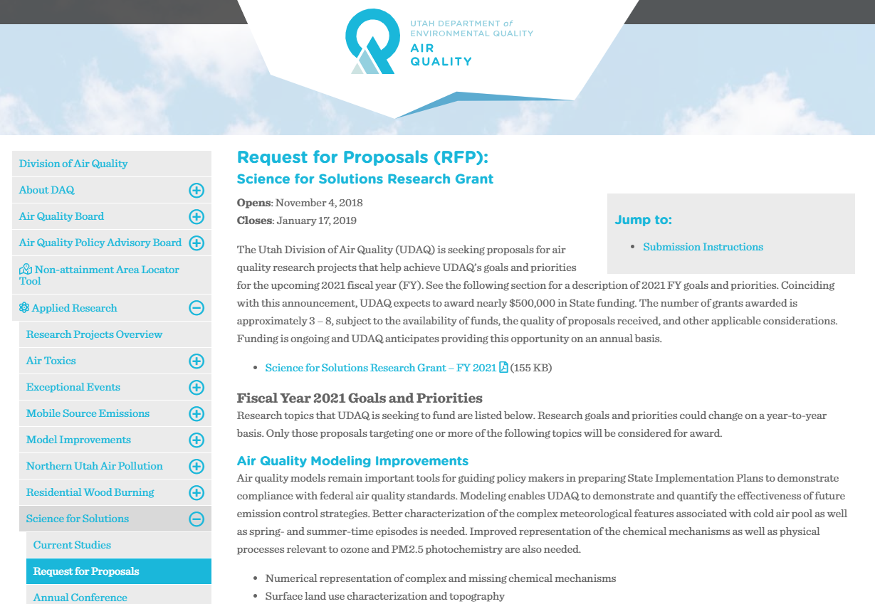

Slide 9
Tips for Submitting a Proposal
Read the RFP more than once
Include all the information requested in the RFP
Explicitly state which goals & priorities you’re addressing in your proposal
Make sure your summary information page matches the information inside your proposal (especially total amount $ requested from UDAQ)
Use the budget template (or similar) included in the RFP
Contact us first (daqresearch@utah.gov) if requesting UDAQ resources as part of your proposal
Send your proposal to daqresearch@utah.gov before the deadline

Slide 10
Questions?
Contact:
cpennell@utah.gov
(801) 536 - 4098

